Slide 1

COVID 19 ANALYSIS WITH TIME SERIES &PROPHET

Slide 2
Presentation Outline
1.INTRODUCTION TO PROJECT
2. WHAT IS TIME SERIES AND PROPHET
3.USED APPROACHES AND TERMS
4.DEMO WITH PROPHET

Slide 3
Introduction
Unfortunately,millions of people lost their lives due to the covid 19. The number of deaths from Covid-19 worldwide has exceeded 4.5 million. With today’s Technologies,we can now make predictions about how many people will die or get better in the coming years. The most advanced way to detect this kind of problem is to use machine learning to our advantage. The aim of this project is to predict the future by creating a time series.

Slide 4
What Is Time Series
Time series is a sequence of observations of categorical or numeric variables indexed by a date,or timestamp. In mathematics, a time series is a series of data points indexed in time order. Most commonly, a time series is a sequence taken at successive equally spaced points in time. Thus it is a sequence of discrete-time data. Examples of time series are height of ocean tides, counts of sunspots and The rise and fall of gold prices in the stock market. Time series are used in statistics, signal processing, pattern recognition, earthquake prediction and largely in any domain of applied science and engineering which involves temporal measurements. Time series analysis comprises methods for analyzing time series data in order to extract meaningful statistics and other characteristics of the data. Time series forecasting is the use of a model to predict future values based on previously observerd values.

Slide 5

What is Prophet
Prophet is a procedure for forcasting time series data based on an additive model where non-linear trends are fit with yearly,weekly, and daily seasonality, plus holiday effects. It works best with time series that have strong seasonal effects and several seasons of historical data.

Slide 6

Prophet is open source software released by Facebook’s Core Data Science team. It is available for download on CRAN and PyPI

Slide 7
Prophet install phase
Prophet is on PyPI, so you can use pip to install it:
pip install pystan == 2.19.1.1
pip install prophet
Before installing Prophet,you must first install Pystan. To install Pystan you must have C++ compiler installed on your computer. Pystan Works on C++

Slide 8
Terms
Prophet follows the sklearn model API. We create an instance of the Prophet class and then call its fit and predict methods.
The input to Prophet is always a dataframe with two columns: ds and y. The ds column should be of a format expected by Pandas YYYY-MM-DD . The y column must be numeric.
Predictions are then made on a dataframe with a column ds containing the dates for which a prediction is to be made.
The predict method will assign each row in future a predicted value which it names yhat. The forecast object here is a new dataframe that includes a column yhat with the forecast,as well as columns for components and uncertainly intervals.

Slide 9
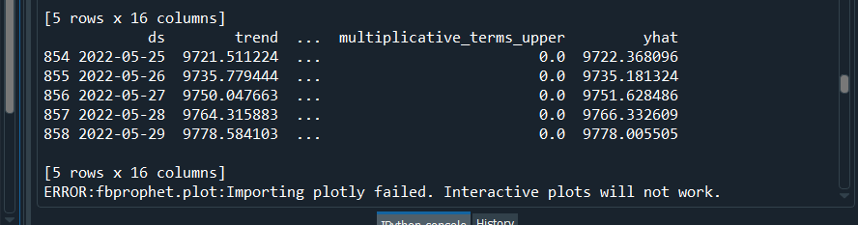

Slide 10
Forecasting Growth
By default,Prophet uses a linear model for its forecast. When forecasting growth, there is usually some maximum achievable point: total market size, total population size, etc. This is called the carrying capacity, and the forecast should saturate at this point.
Prophet allows you to make forecasts using a logistic growth trend model,with a specified carrying capacity.

Slide 11
What is Linear Model
In statistics, the term linear model is used in different ways according to the context. The most common occurrence is in connection with regression models and the term is often taken as synonymous with linear regression model. However, the term is also used in time series analaysis.

Slide 12
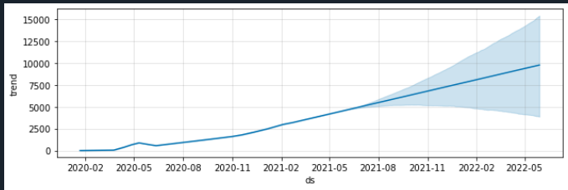

Slide 13
What is Cross Validation
Cross-validation is a statistical method used to estimate the skill of machine learning models.
It is commonly used in applied machine learning to compare and select a model for a given predictive modeling problem because it is easy to understand, easy to implement, and results in skill estimates that generally have a lower bias than other methods. Prophet includes functionality for time series cross validation to measure forecast error using historical data. This is done by selecting cutoff points in the history, and for each of them fitting the model using data only up to that cutoff point. We can then compare the forecasted values to the actual values.

Slide 14
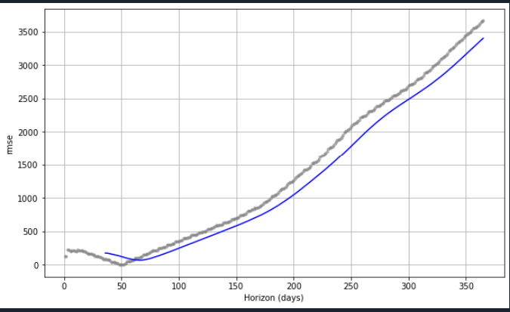

Slide 15
References:
https://facebook.github.io/prophet/
https://en.wikipedia.org/wiki/Linear_model
https://en.wikipedia.org/wiki/Time_series
https://en.wikipedia.org/wiki/Cross-validation_(statistics)

Slide 16
Demo
Thanks for listening. Now we will have a quick demo about the project.

